Slide 1

Progress Report
Michael Lee
July 20th, 2022

Slide 2
What was done
Phase recovery code with PyTorch & Holotorch
Code for generating synthetic WISHED [add citation here] data
Used PyTorch optimization, NOT Gerchberg-Saxton
PyTorch optimization converges faster than G.S.
Say something about models
Bug finding

Slide 3
CONTEXT AND BACKGROUND

Slide 4
FIRST PROBLEM TO SOLVE
How to recover optical wavefronts?

Slide 5
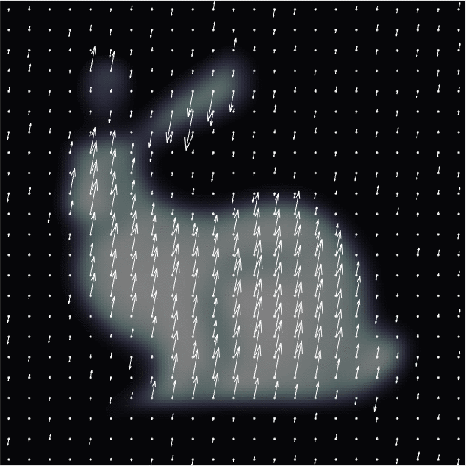
Objective
Want to reconstruct optical wavefronts
I.e. recover amplitude and phase of optical fields
Field has…
Amplitude (arrow length)
and
Phase (oscillation offsets)

Slide 6
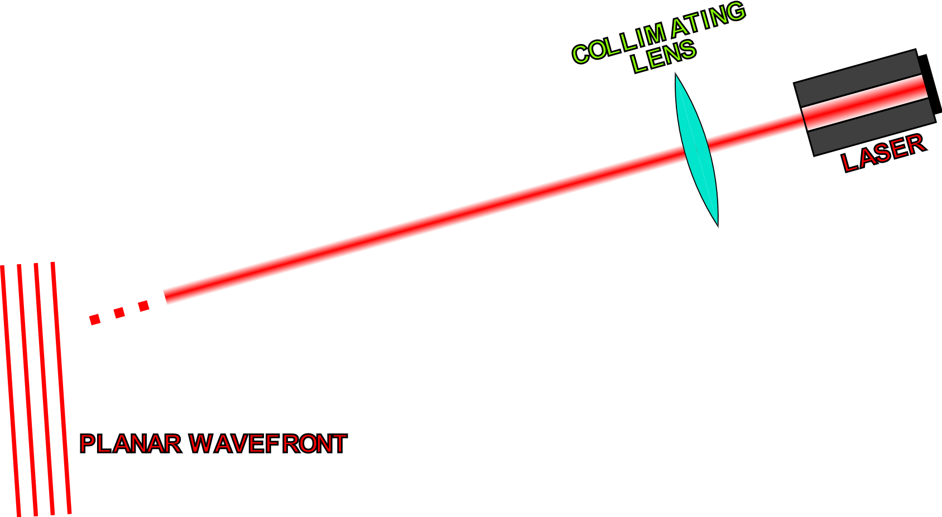
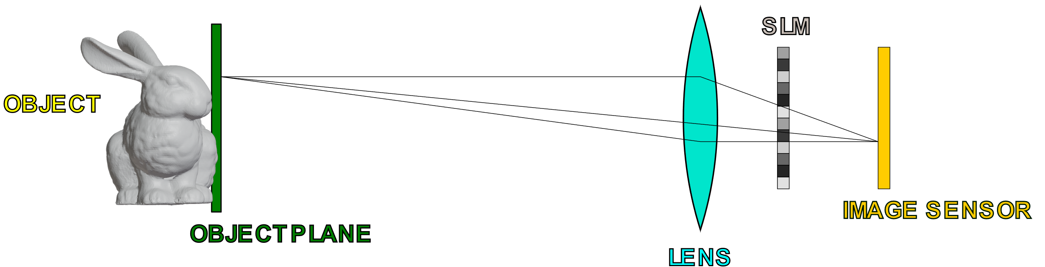
Real Life Setup

Slide 7
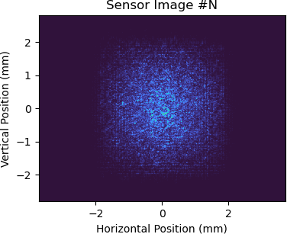
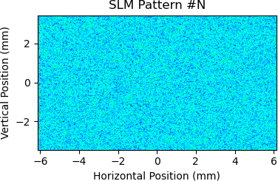
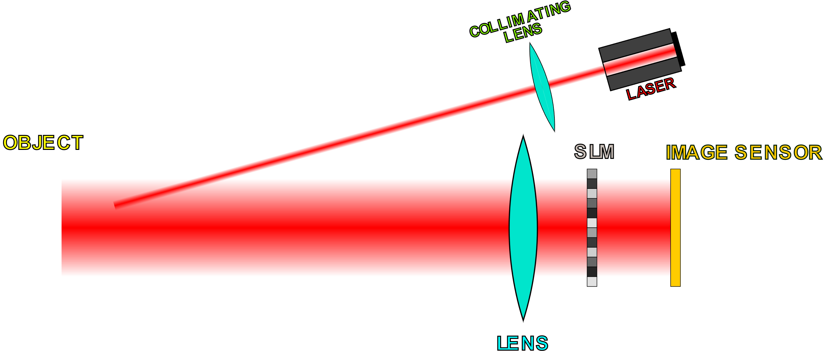
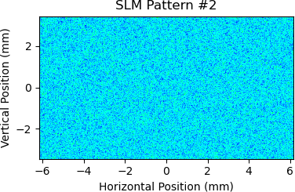
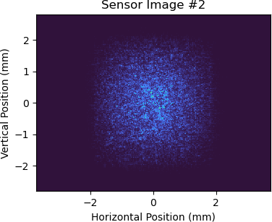
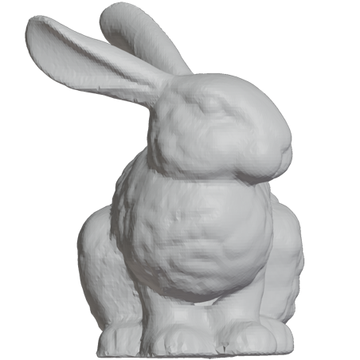
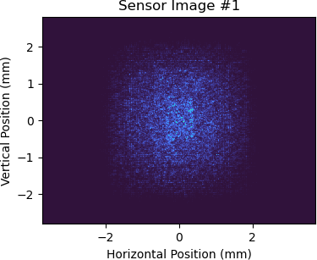
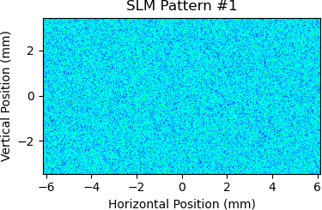
Obtaining Real (Non-Synthetic) Data
Save SLM and sensor data
Recorded Data
Acquire image from sensor
…
Display random phase pattern on SLM
Can use this data in conjunction with a model for SLM-to-sensor propagation to recover the complex field at the image sensor

Slide 8
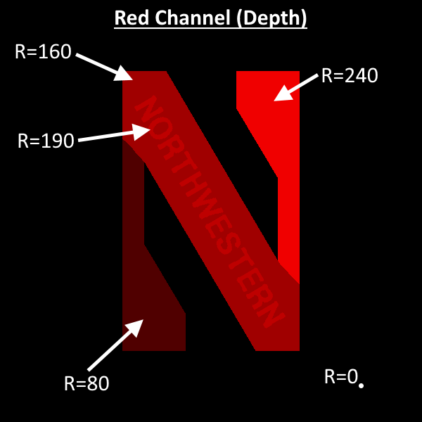
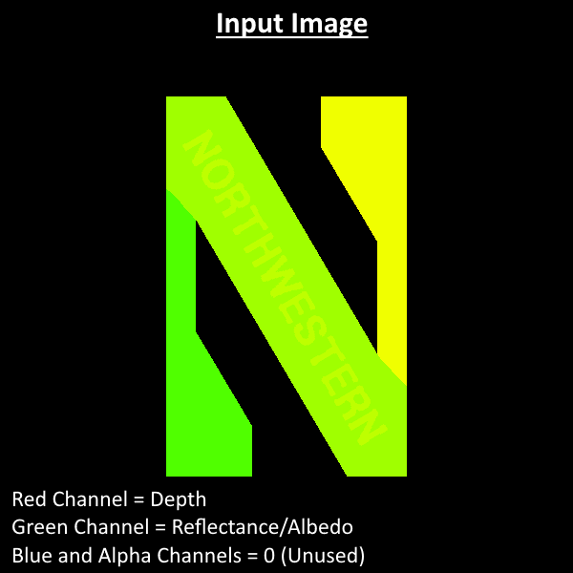
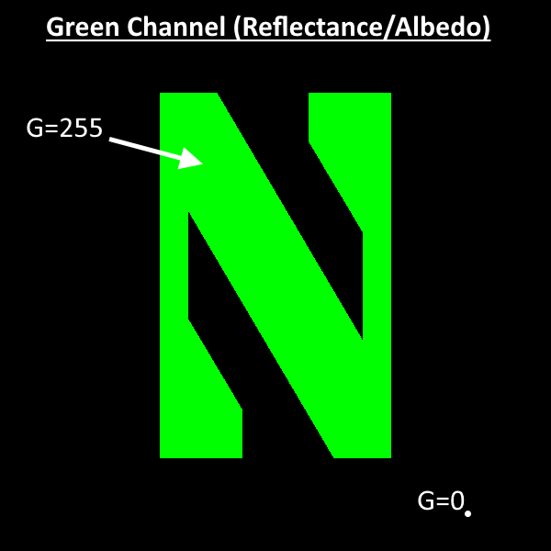
Synthetic Data Generator Input
{

Slide 9
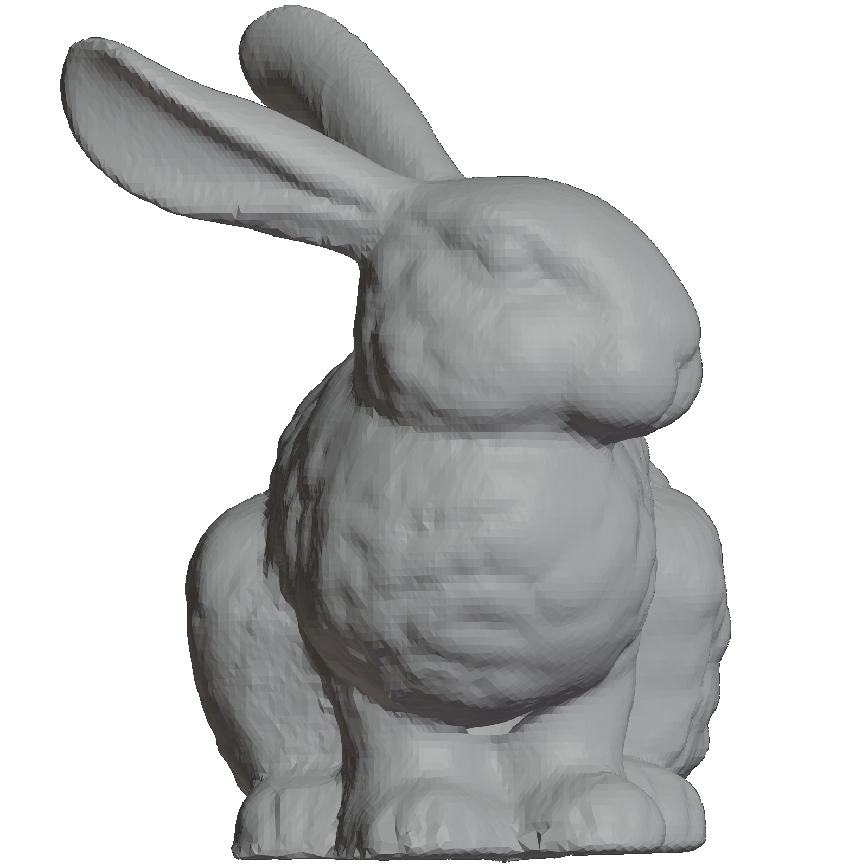
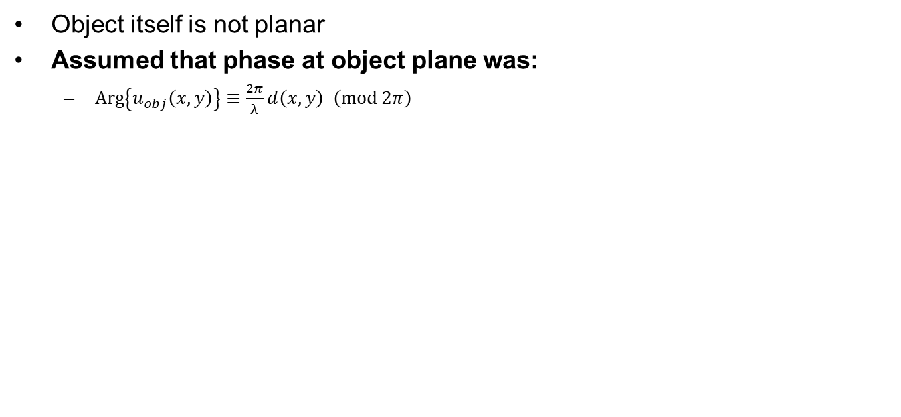
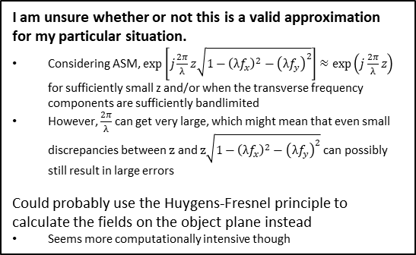
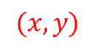
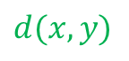
Generating Object Plane Fields
Object itself is not planar
Assumed that phase at object plane was:
$\operatorname{Arg}\left\{u_{obj}\left(x,y\right)\right\}≡\frac{2π}{λ}d\left(x,y\right) \left(\operatorname{mod}{2π}\right)$
$$d(x,y)$$
$$(x,y)$$
I am unsure whether or not this is a valid approximation for my particular situation.
Considering ASM, $\exp\left[j\frac{2π}{λ}z\sqrt{1−{\left(λf_{x}\right)}^{2}−{\left(λf_{y}\right)}^{2}}\right]≈\exp\left(j\frac{2π}{λ}z\right)$ for sufficiently small z and/or when the transverse frequency components are sufficiently bandlimited
However, $\frac{2π}{λ}$ can get very large, which might mean that even small discrepancies between $z$ and $z\sqrt{1−{\left(λf_{x}\right)}^{2}−{\left(λf_{y}\right)}^{2}}$ can possibly still result in large errors
Could probably use the Huygens-Fresnel principle to calculate the fields on the object plane instead
Seems more computationally intensive though
Object plane

Slide 10
Model for Synthetic Data Generation

Slide 11
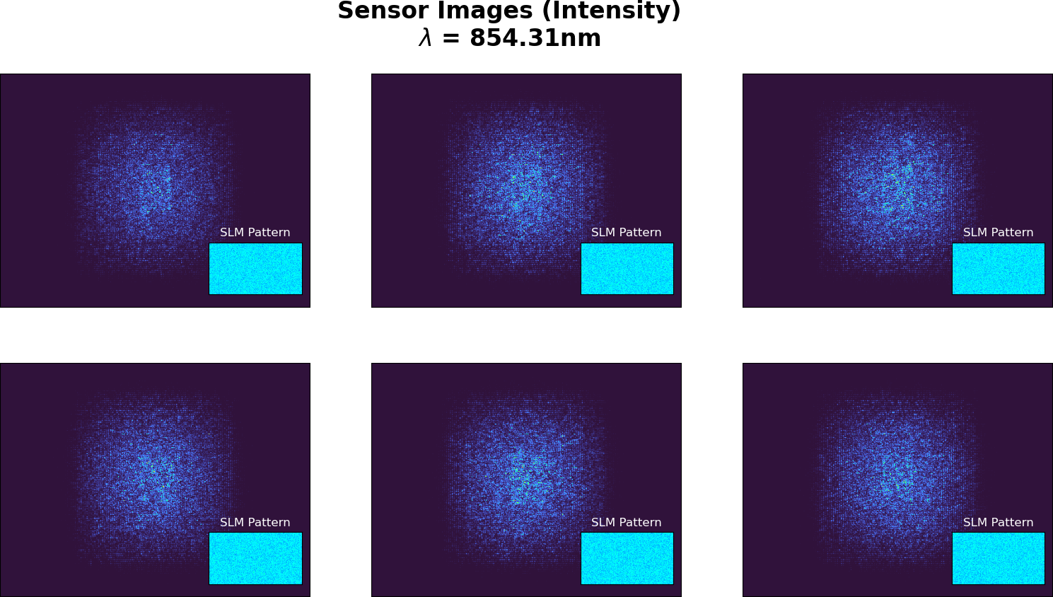
Synthetic Data Example

Slide 12
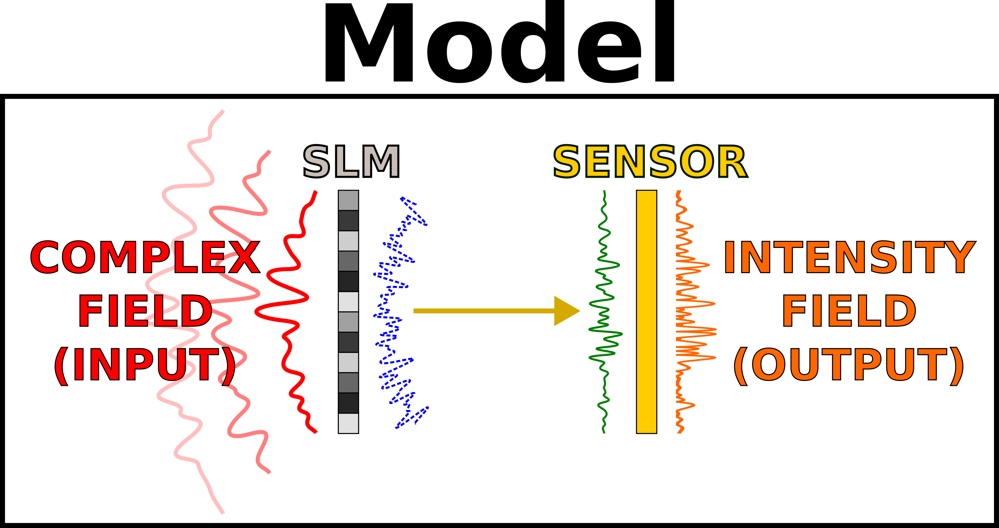
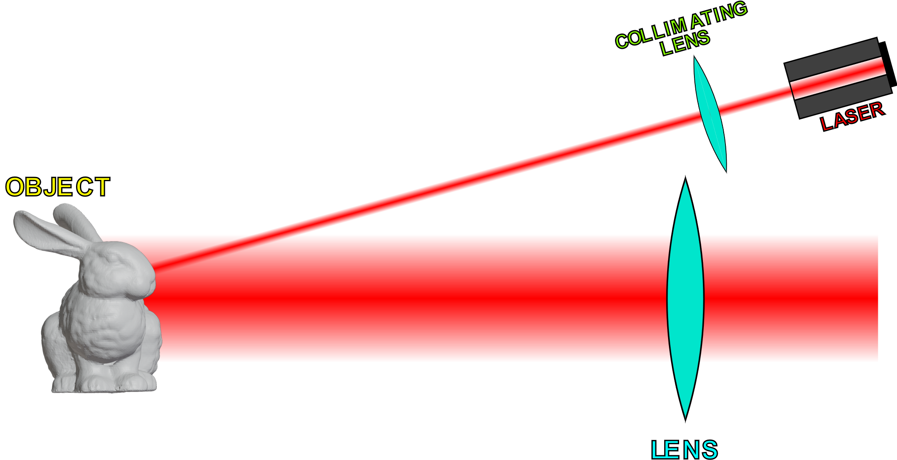
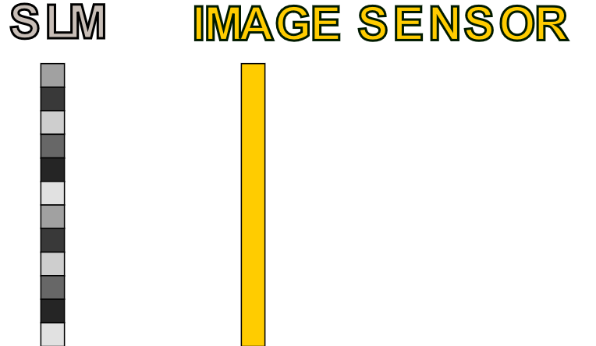
Recovering Complex Fields
Objective
Recover field (phase + amplitude) at
the image sensor
Phase Retrieval
Algorithm
Sensor Plane
Complex Fields
Can do phase retrieval
to accomplish this
…
SLM Patterns
and
Sensor Data
Can focus on SLM and sensor
while disregarding the rest

Slide 13
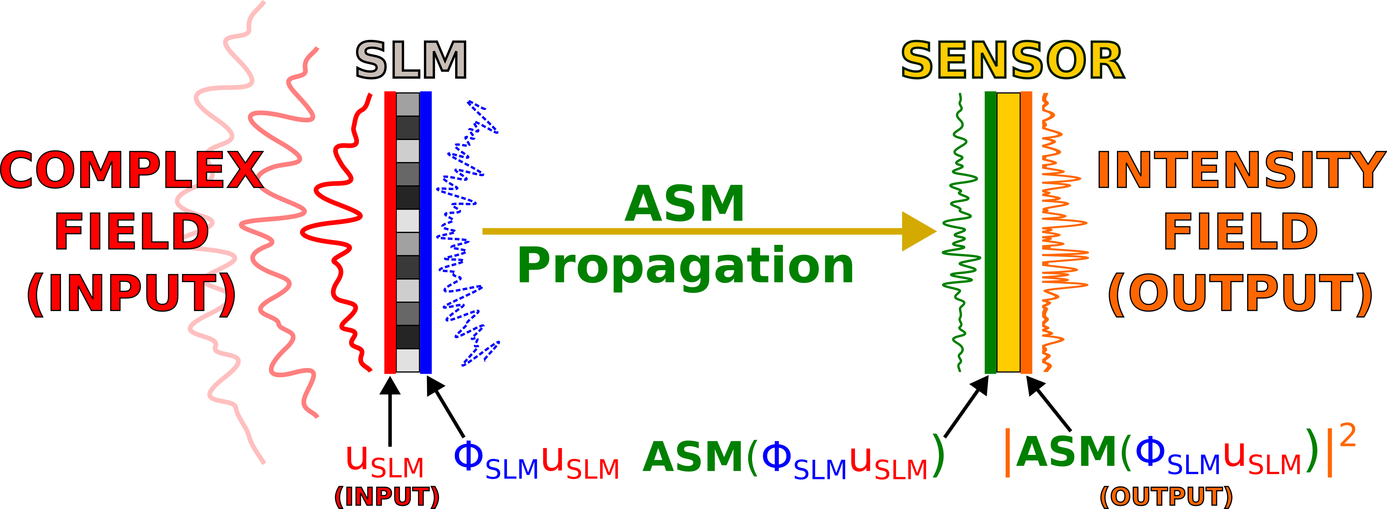
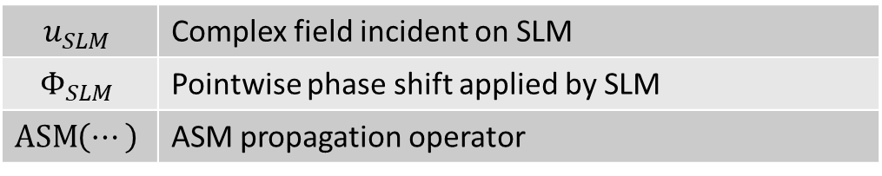
Forward Model
$$u_{SLM}$$ | Complex field incident on SLM
$$Φ_{SLM}$$ | Pointwise phase shift applied by SLM
$$\operatorname{ASM}\left(⋯\right)$$ | ASM propagation operator

Slide 14
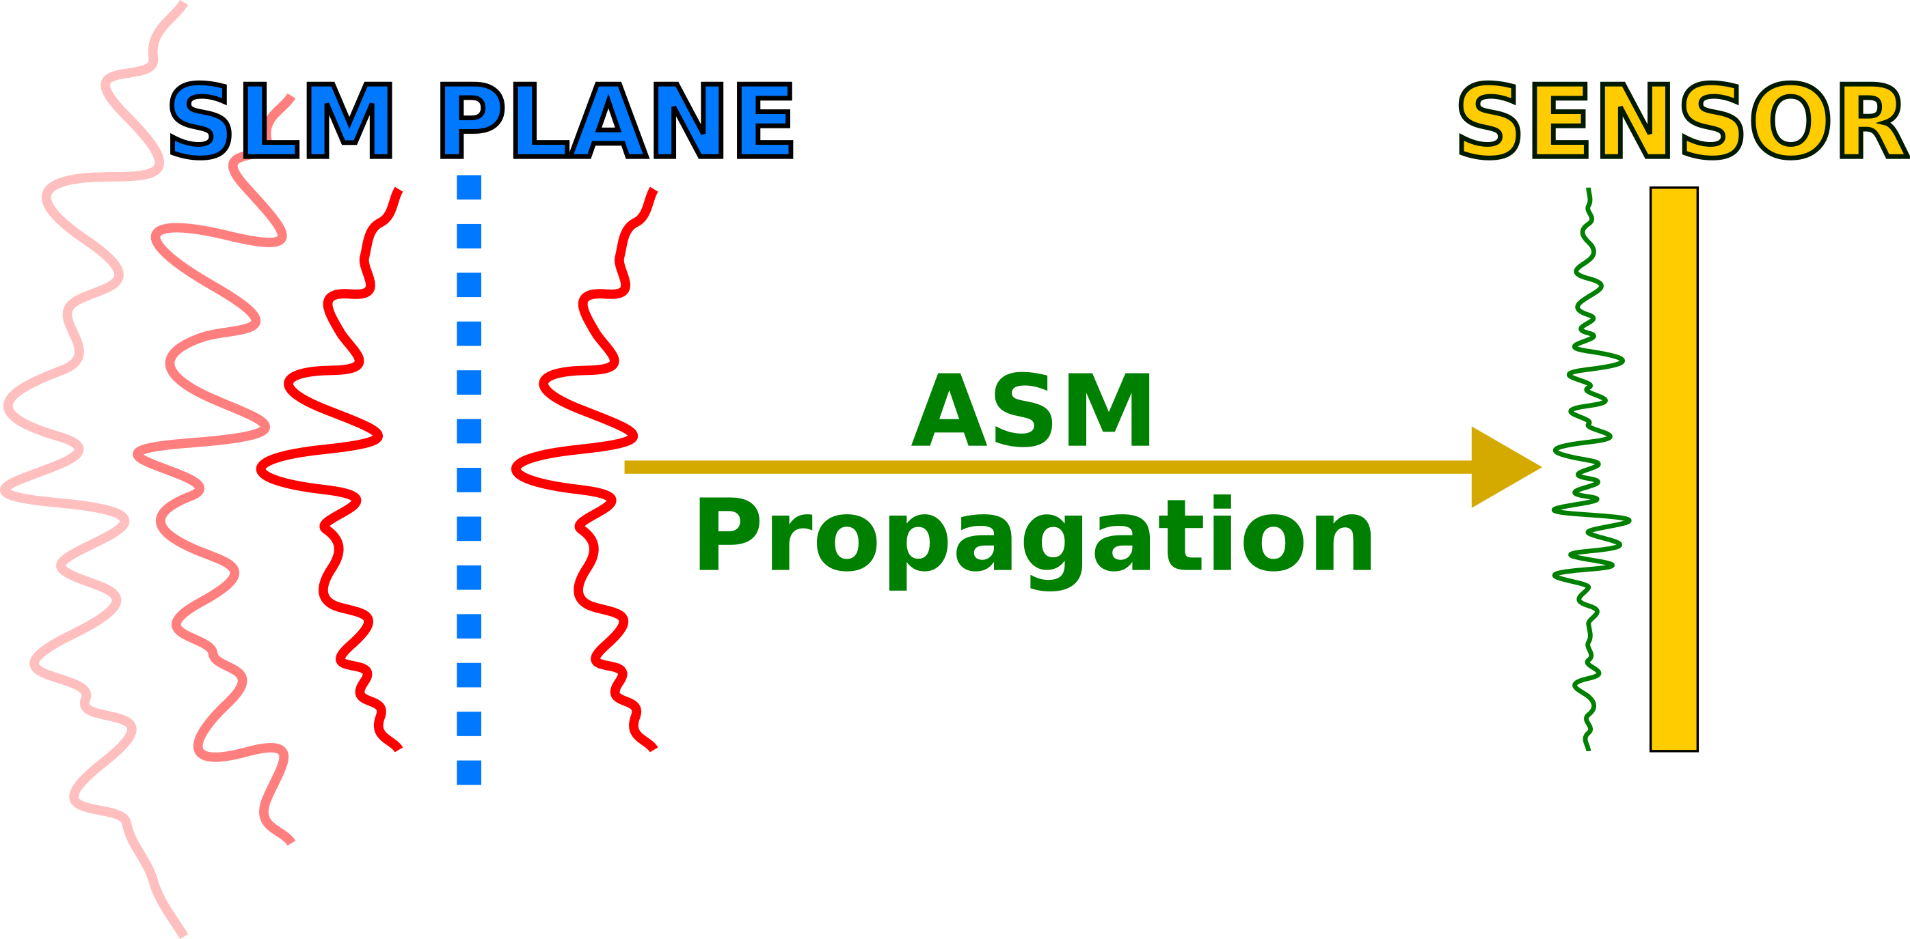
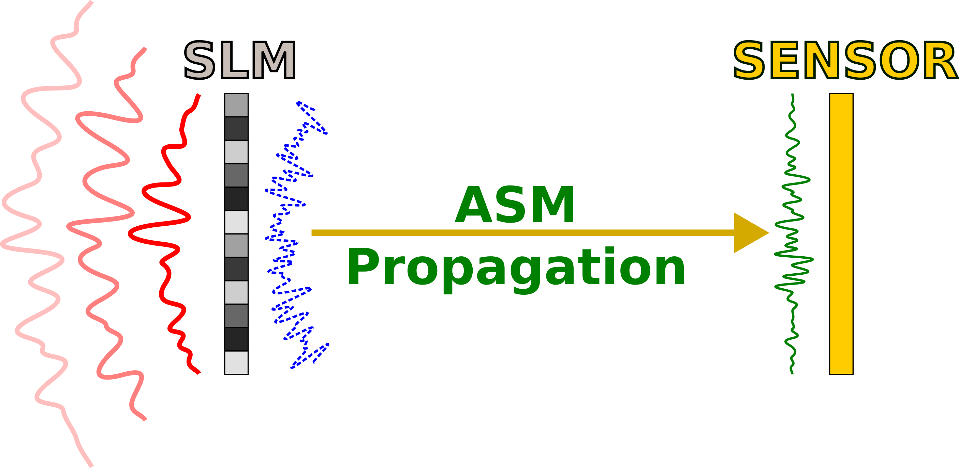
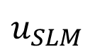
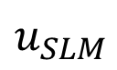
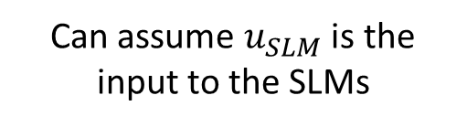
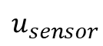
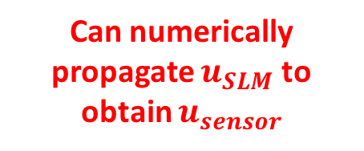
Recovering Sensor Plane Field
SUMMARY
To recover sensor fields:
1. Recover SLM input field
2. Numerically propagate the SLM input field to get the sensor field
Can assume $u_{SLM}$ is the input to the SLMs
Can numerically propagate $u_{SLM}$ to obtain $u_{sensor}$
$$u_{SLM}$$
$$u_{sensor}$$
$$u_{SLM}$$
Hypothetical field w/o SLM

Slide 15
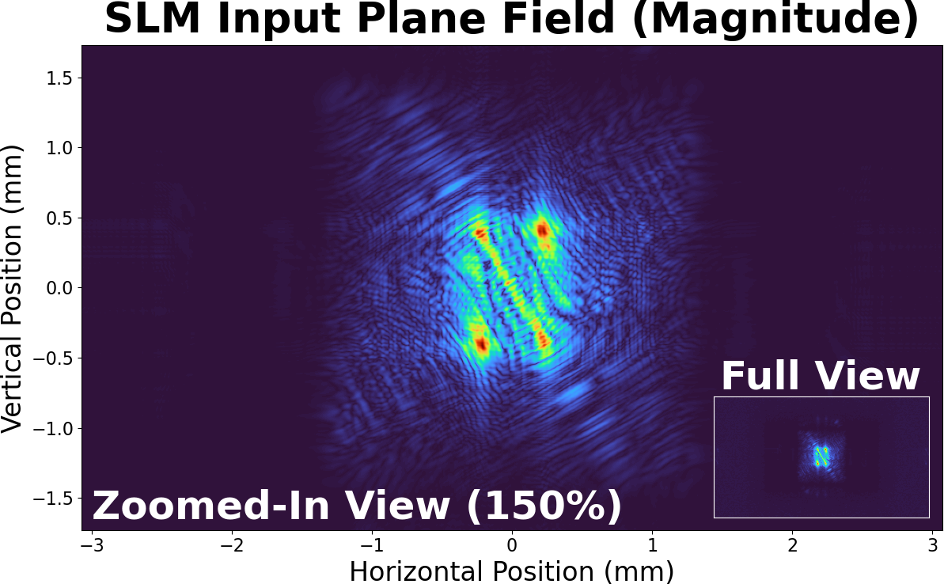
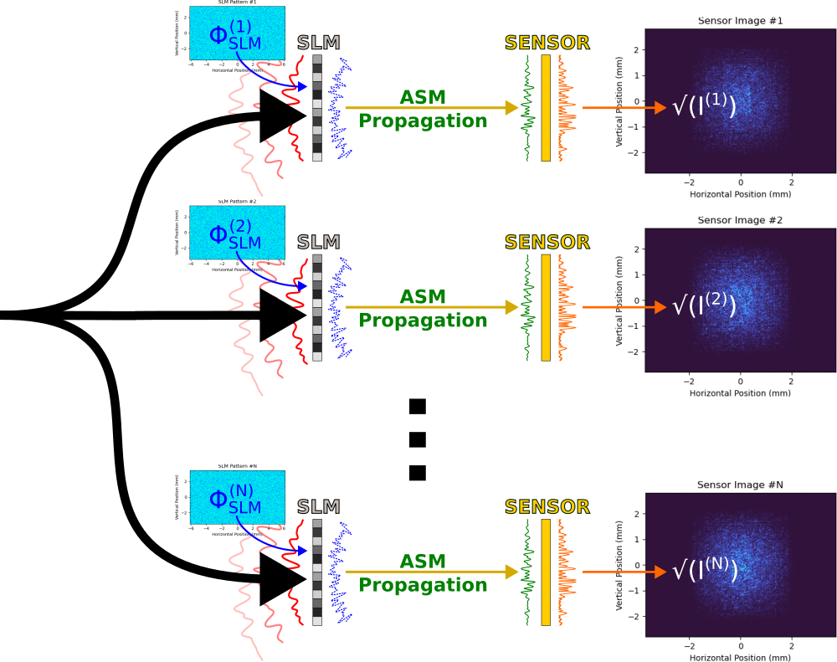
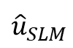
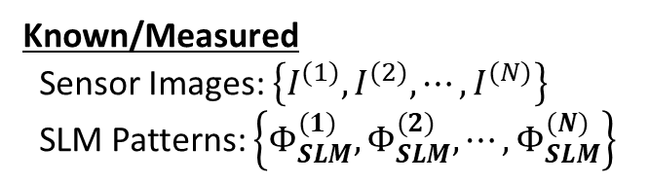
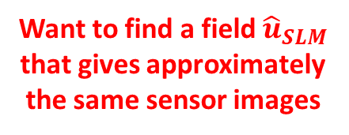
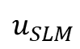
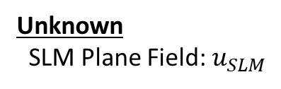
Estimating SLM Input with Optimization
?
Unknown
SLM Plane Field: $u_{SLM}$
$$u_{SLM}$$
Want to find a field ${\hat{u}}_{SLM}$ that gives approximately the same sensor images
$${\hat{u}}_{SLM}$$
Can use optimization accomplish this
Known/Measured
Sensor Images: $\left\{I^{(1)},I^{(2)},⋯,I^{(N)}\right\}$
SLM Patterns: $\left\{Φ_{SLM}^{(1)},Φ_{SLM}^{(2)},⋯,Φ_{SLM}^{(N)}\right\}$

Slide 16
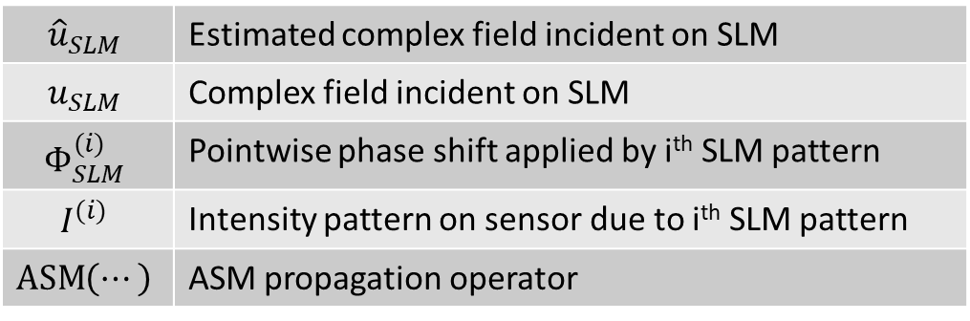
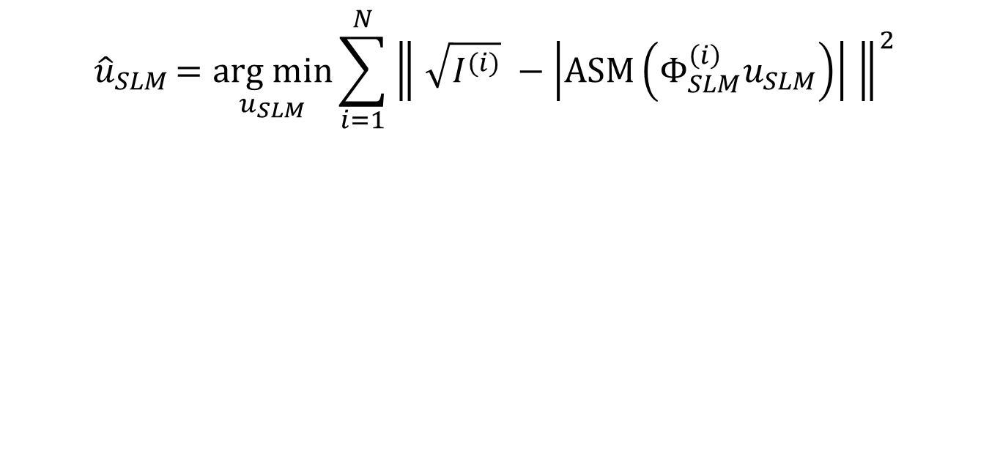
Optimization Objective Function
$${\hat{u}}_{SLM}=\underset{u_{SLM}}{arg min}{\sum_{i=1}^{N}{{\left\| \sqrt{I^{(i)}} −\left|\operatorname{ASM}\left(Φ_{SLM}^{\left(i\right)}u_{SLM}\right)\right| \right\|}^{2}}}$$
CORE IDEA |
Minimize error between measured intensity patterns and intensity patterns output by model
$${\hat{u}}_{SLM}$$ | Estimated complex field incident on SLM
$$u_{SLM}$$ | Complex field incident on SLM
$$Φ_{SLM}^{(i)}$$ | Pointwise phase shift applied by i^{th} SLM pattern
$$I^{(i)}$$ | Intensity pattern on sensor due to i^{th} SLM pattern
$$\operatorname{ASM}\left(⋯\right)$$ | ASM propagation operator

Slide 17
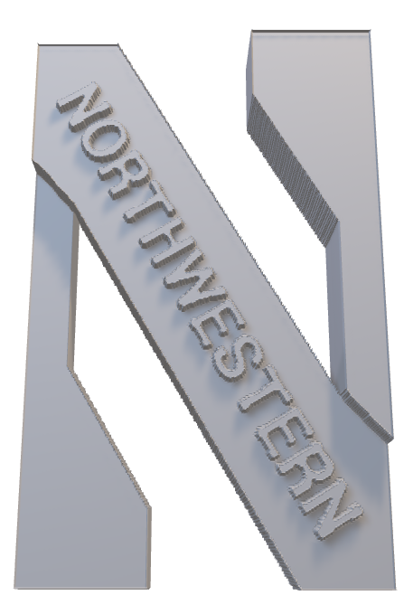
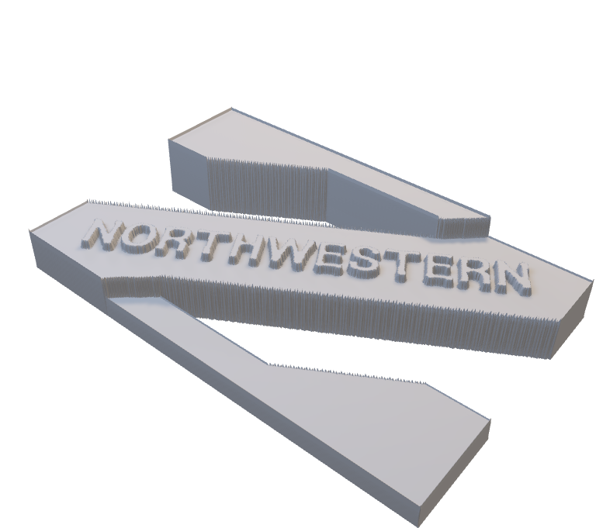

Slide 18
Note phase only SLM
Note that PyTorch/Holotorch works quite well

Slide 19
Implementation Details

Slide 20
Stuff to add
Pictures of SLM patterns
Pictures of intensity patterns
Stuff about Gerchberg-Saxton
I.e. how inverting propagation was done

Slide 21
Stuff to improve
Readability of labels

Slide 22
Other
Write for an audience who is not familiar with the work
Specify the problem being solved
I.e. given intensity patterns from SLMs, recover phase at plane before SLM

